Slide 1
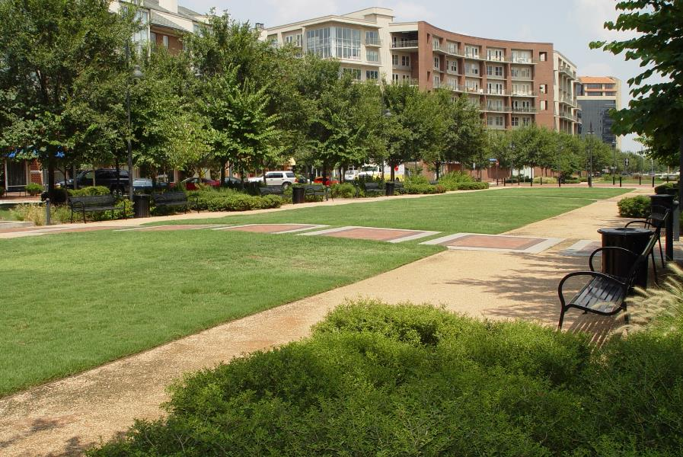
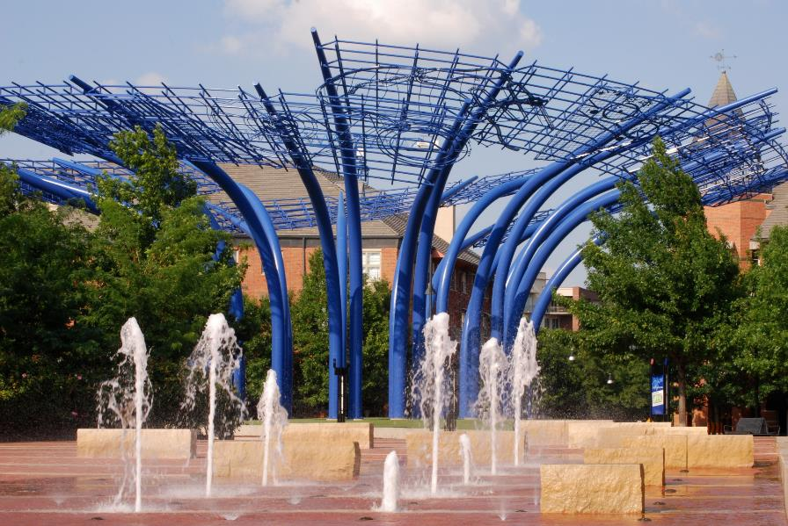

addison, texas unified development code
Part 3 (Procedures) + Part 1 revisit (Districts & Uses)
April 2024

Slide 2
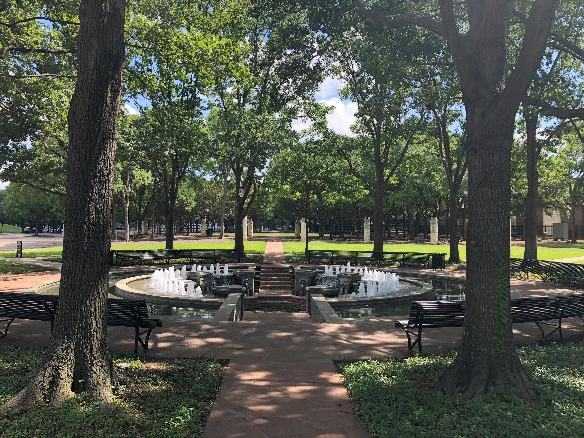
Team Members
Matt Goebel, AICP
Clarion - Project Manager
Code Drafting
Gabby Hart, AICP
Clarion - Project Associate
Code Drafting
Jim Dougherty, Esq.
Texas Land-use Law Expert

Slide 3
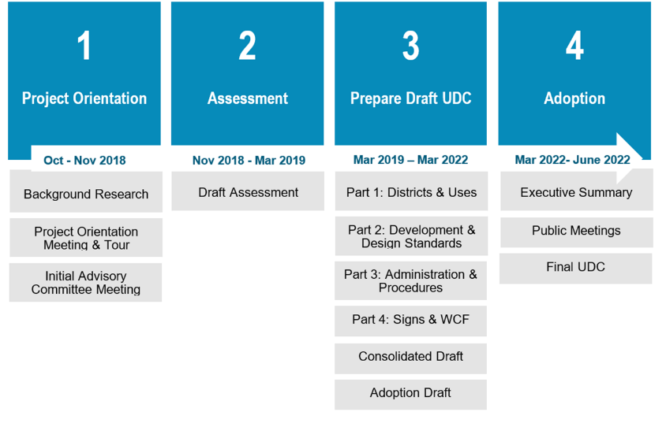
Project Scope and Timeline
Mar 2019 – July 2024
July 2024 – Dec 2024
Revisit
Finish Content

Slide 4
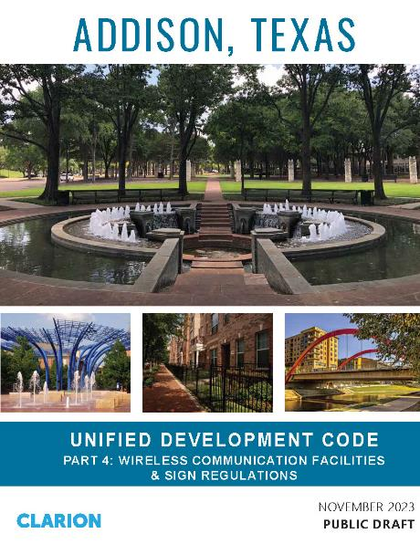
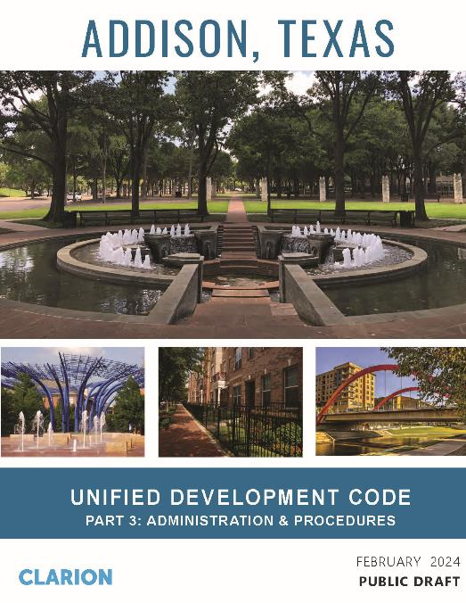
Meeting Agenda
Review and discuss final installments:
  Common review procedures
  Specific procedures (part 1)
Revisit Zoning Districts & Uses installment
Next steps

Slide 5
New UDC Organization
Article 1: General Provisions
Article 2: Administrations and Procedures
Article 3: Zoning Districts
Article 4: Use Regulations
Article 5: Development Standards
Article 6: Subdivision Standards
Article 7: Definitions

Slide 6
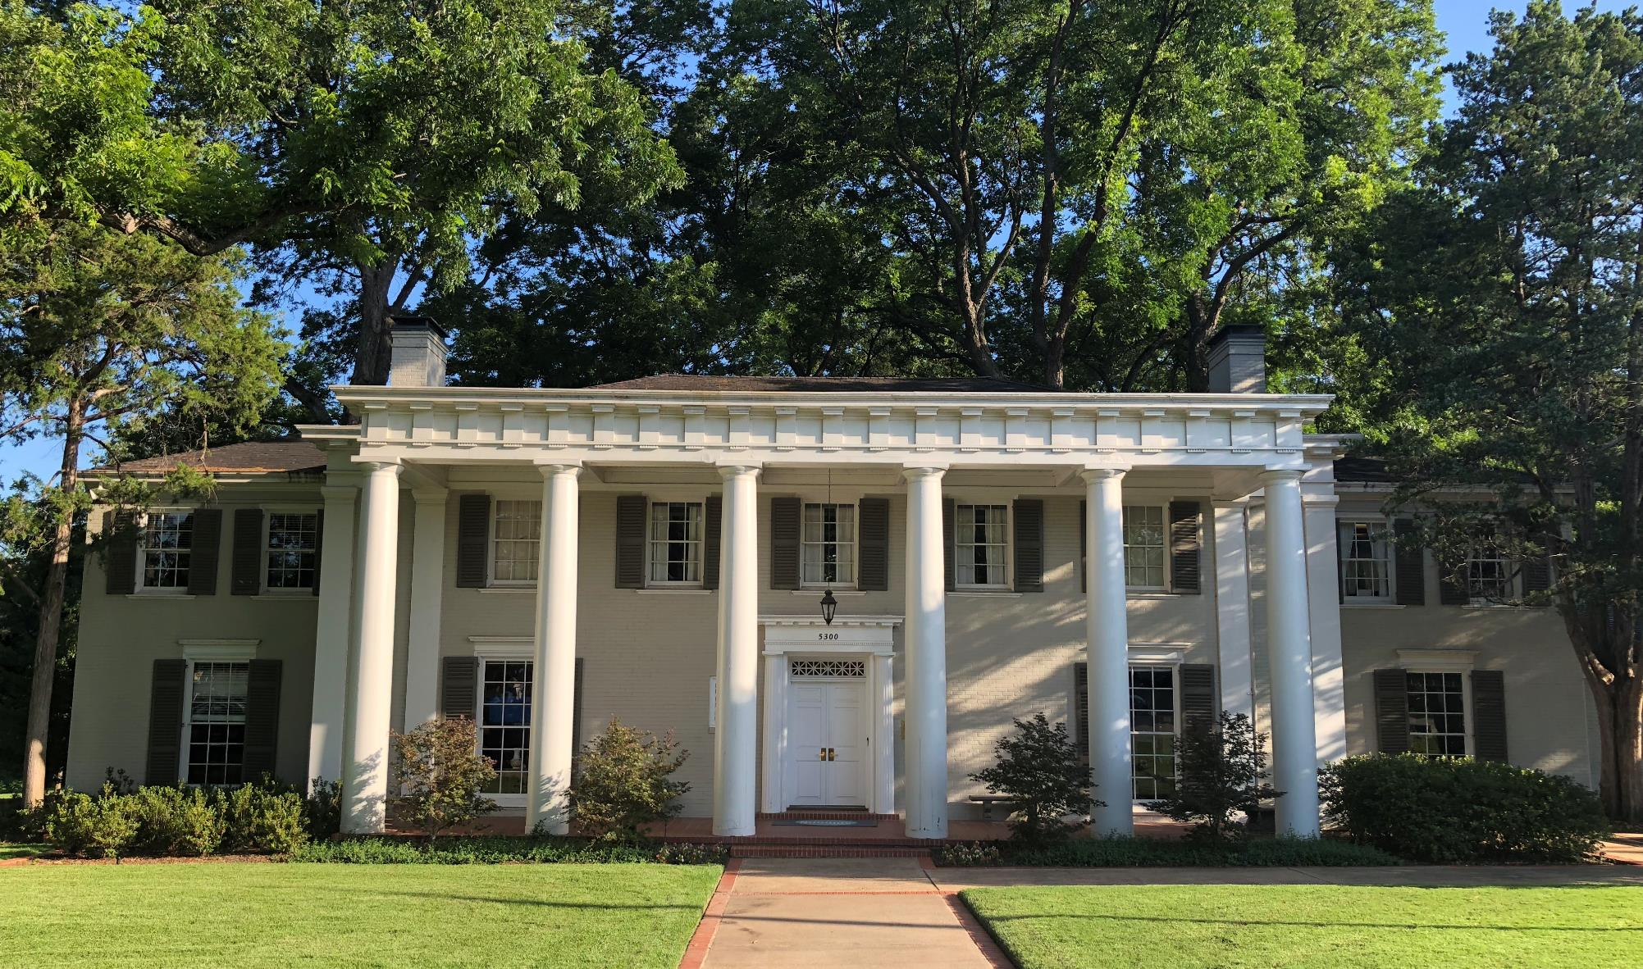
Administration & Procedures
Pt.2

Slide 7
Organization
Purpose
Organization
Summary Table of Review Procedures
Common Review Procedures
Rezoning, Zoning Text, and Plan Amendments
Site Planning and Miscellaneous Permits
Engineering Plans, Studies, and Site Development Permits
Agreements
Platting of Land
Flexibility and Relief
Foundational elements
Procedures that build on the foundation

Slide 8
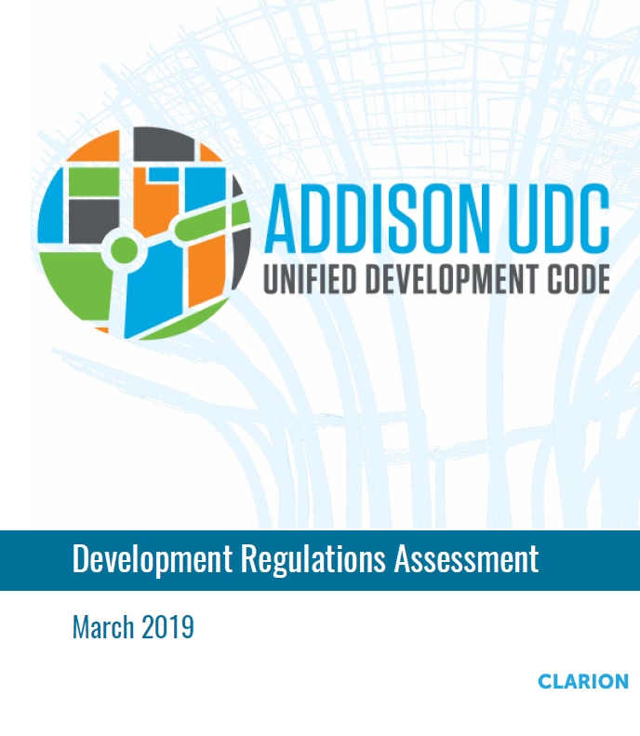
Key Goals
Delegate more decision-making power to staff
Establish common review procedures
Codify and update the site plan review procedures
Establish process to allow minor modifications

Slide 9
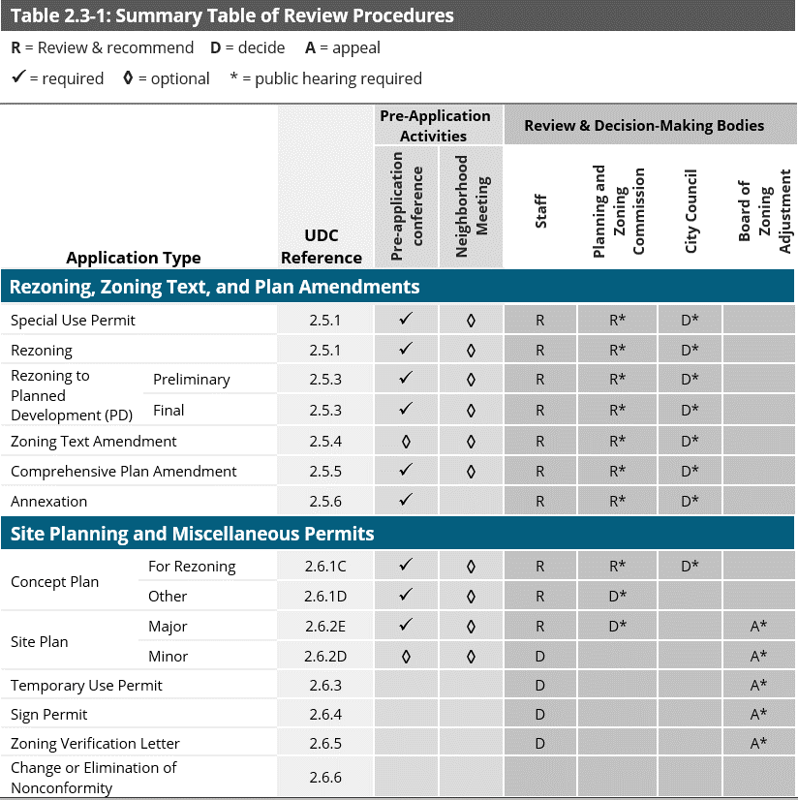
Topics Covered Previously
General Provisions
Nonconformities
Review & Decision-Making Bodies
Summary Table of Review Procedures

Slide 10
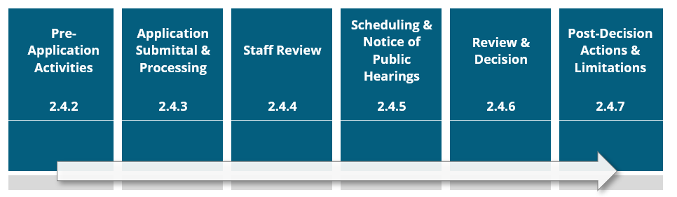
Common Procedures
Elements that are common to most development application reviews
Consolidated to avoid repetition
Substantially rewritten for clarity and to reflect current practice

Slide 11
Common Procedures
Pre-application conference
Neighborhood Meeting
Application Submittal & Processing
Staff Review
Public Hearing Scheduling & Notice
Review and Decision
Post-Decision Actions & Limitations

Slide 12
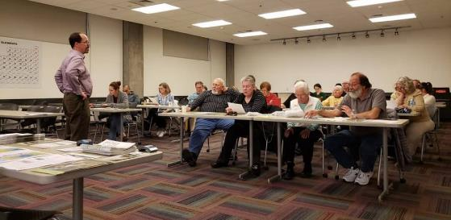
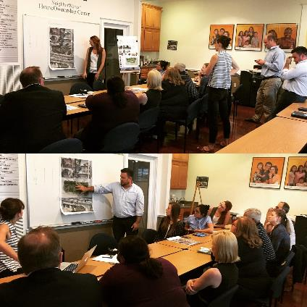
Common Procedures |Key Changes
New neighborhood meeting process to allow public involvement earlier in the review process for major projects
Recommended for any application subject to discretionary review by the Planning and Zoning Commission
Applicant responsible for scheduling, noticing, and facilitating the meeting – attendance by Town staff not required
Summary of meeting required to be provided in application materials and staff report

Slide 13
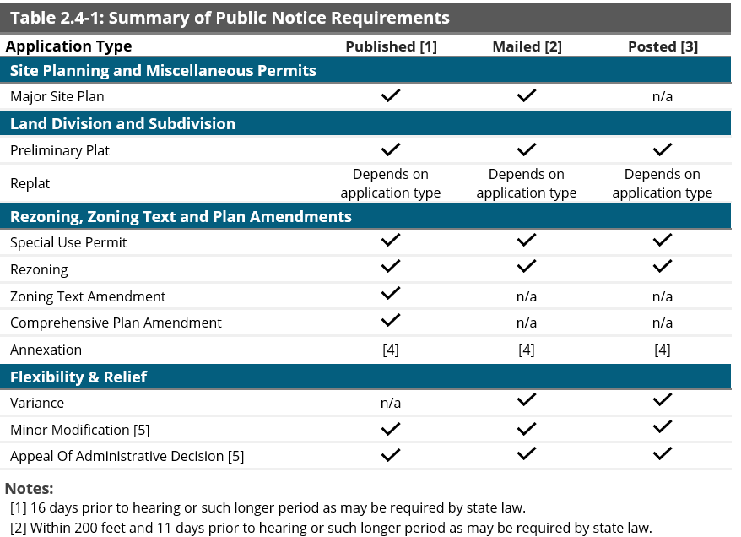
Common Procedures |Key Changes
Scheduling and notice of public hearing section added to provide more direction and clarity regarding Town procedures
Includes minimum time frames for mailed, published (newspaper or online), and posted (signs on property) notice
New summary table of public notice requirements

Slide 14
Common Procedures |Key Changes
New Post-Decisions Actions and Limitations section establishes:
  Notice of decision on an application to be provided within 10 days after decision
  When development approvals expire, if they can be extended, and the ability for approvals to be revoked
  Ability for the Director to approve minor changes to approved plans including:
      Changes necessary in light of technical or engineering considerations first discovered during preparation of final engineering and building plans
      Minor deviations in building footprint
      Relocation of infrastructure (roads and water or sewage lines)
      NOT reductions to amount of open space, buffering, or increase in building floor area

Slide 15
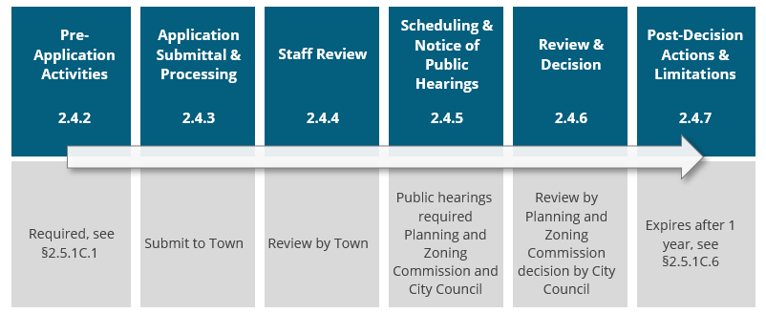
Special Use Permit
Required for all land uses allowed by Special Use Permit (S) in Table of Allowed Uses

Slide 16
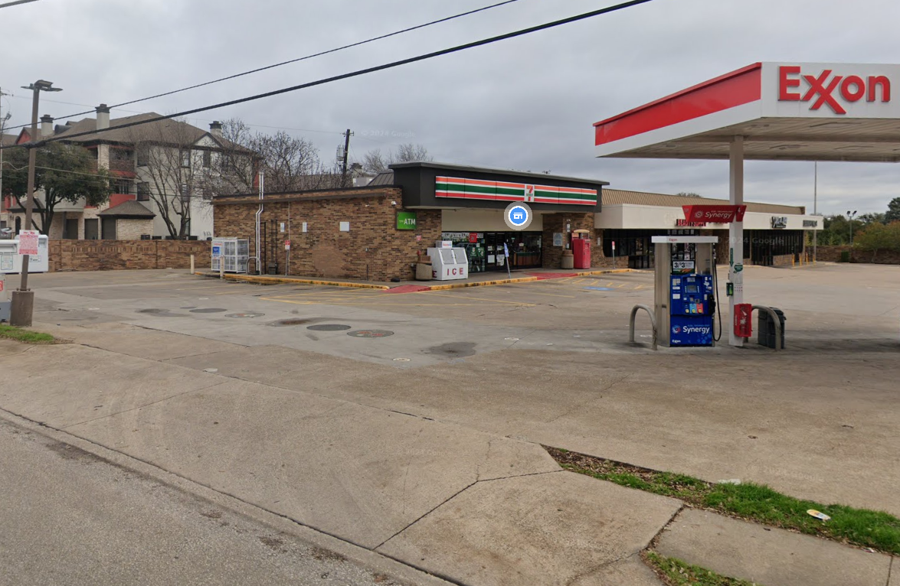
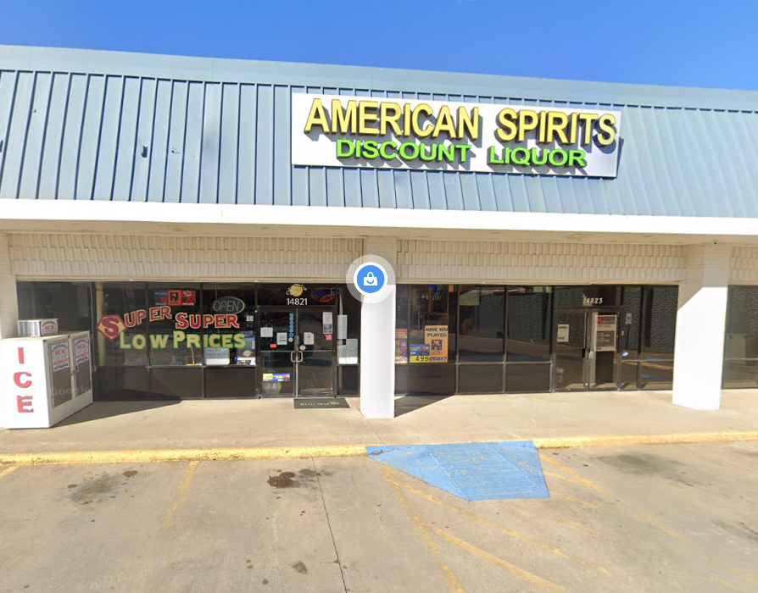
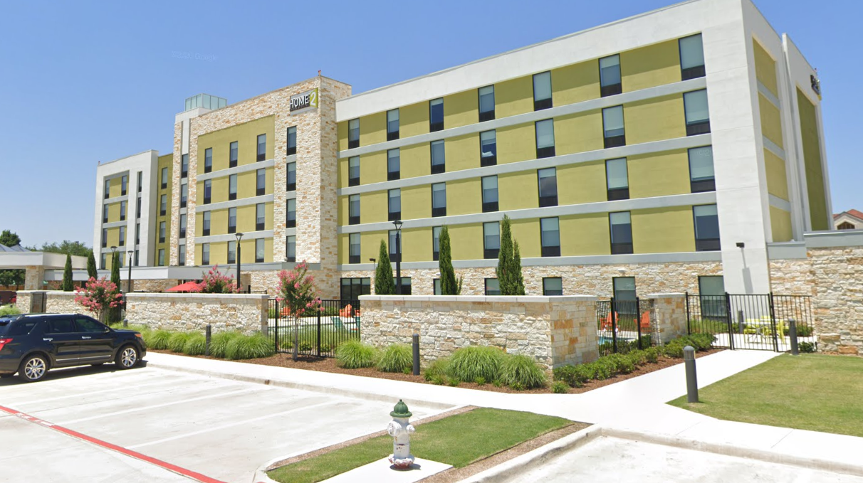
Special Use Permit
Considers the location, design, configuration, intensity, density, natural hazards, and other relevant factors pertaining to the proposed use to evaluate the potential impacts of such uses on surrounding properties and to ensure that such uses are compatible with surrounding properties

Slide 17
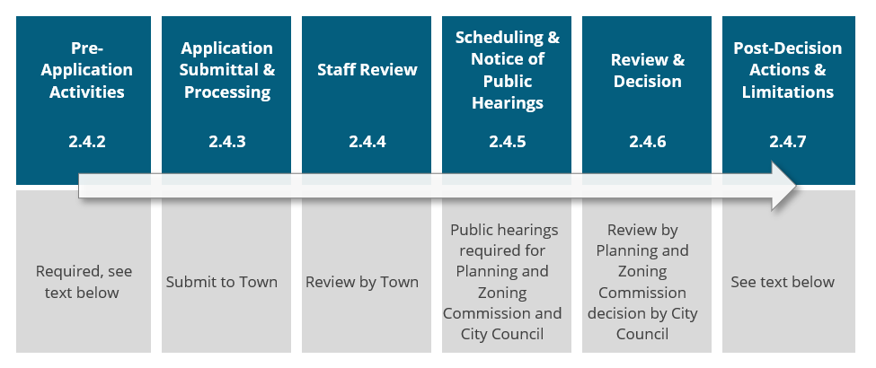
Rezoning
Neighborhood meeting recommended
Includes procedure for written protest and overrule of rezoning decisions

Slide 18
Rezoning
Rezoning review criteria:
  Is consistent with the Comprehensive Plan and the purposes of this UDC;
  Is consistent with the purpose statement of the proposed zoning district;
  There have been significant changes in the area to warrant a zoning change;
  The intensity of development in the new zoning district is not expected to create significantly adverse impacts to surrounding properties or the neighborhood; and
  Public facilities and services are available to adequately serve the subject property while maintaining adequate level of service to existing development; and/or:
  There was an error in establishing the current zoning.

Slide 19
Rezoning
Rezoning to Planned Development (PD) follows same overall process for two different steps:
  Preliminary PD Concept Plan: evaluate and discuss basic concepts of the proposed PD and whether it will result in a significant improvement over its development within a base zoning district
  Final PD Site Plan: prepare detailed engineering and site plans that respond to any issues raised during the review of the Preliminary PD Concept Plan
Goal to move away from site-specific PD applications and use the Major Site Plan process, reserving PDs for larger, more complex and unique development projects

Slide 20
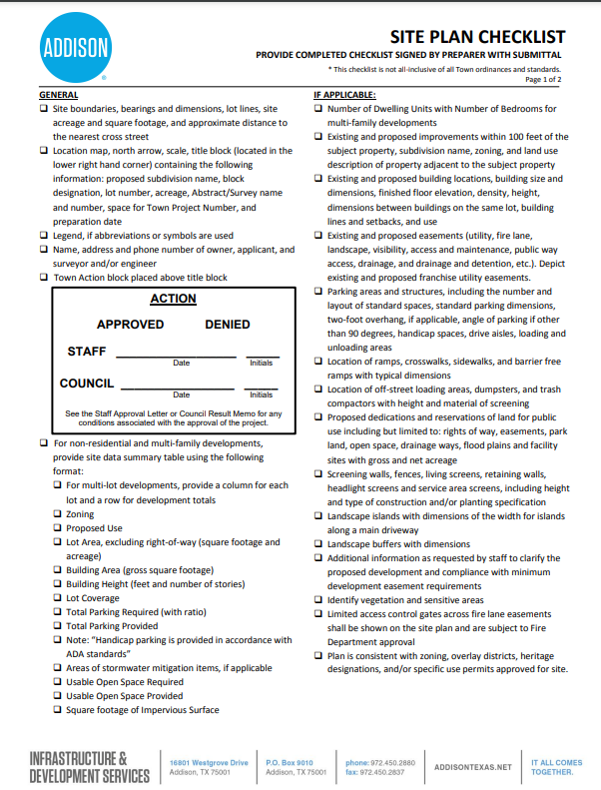
Site Plan Review
Establishes a specific procedure to reflect current Town practices
Proposed Major and Minor Site Plan processes
Minor Site Plan Thresholds
  Single use in an existing structure less than 10,000 square feet gross floor area
  Combination of uses in an existing structure less than 20,000 square feet gross floor area
  New nonresidential structure less than 5,000 square feet gross floor area
  Single-family attached development of 40 or fewer dwelling units
  Minor redevelopment

Slide 21
Site Plan Review
Minor redevelopment (as initially proposed in Development Standards installment)
  Expansions, alterations, or modifications that increase the gross floor area of an existing structure by the greater of 10,000 square feet or between 10 and 50 percent;
  Expansions, alterations, or modifications that increase the total number of existing dwelling units on a lot by the lesser of 10 dwelling units or between 10 and 25 percent;
  The alteration or expansion of any vehicular parking area by the greater of six spaces or 50 percent, excluding resurfacing or restriping;
  Any expansion or enlargement of a structure or land use that requires a Special Use Permit; or
  Applications for building permits or for certificates of occupancy for buildings previously unoccupied for a period of six consecutive months.

Slide 22
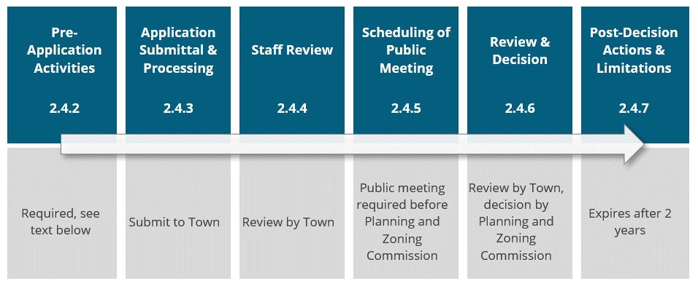
Site Plan Review
Major Site Plan
  Neighborhood Meeting recommended
  Public meeting, not hearing, required

Slide 23
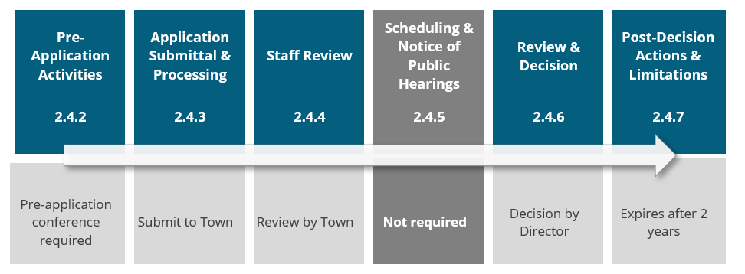
Site Plan Review
Minor Site Plan Procedure

Slide 24
Site Plan Review
Approval Criteria for both Minor and Major Site Plans
  Compliance with UDC and other applicable plan regulations (Comprehensive Plan)
  Compliance with prior approvals
  Compliance with phasing plans
Major and Minor Site Plan decisions can be appealed to the Board of Zoning Adjustment

Slide 25
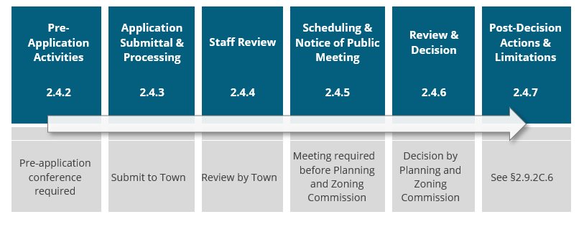
Subdivision | Preliminary Plat
Procedure applies to subdivisions that:
  Involve land that has not yet been platted
  Involve land that will be developed in phases
  Include dedication of public right-of-way or major public improvements
*Final Plat must be submitted within two years

Slide 26
Subdivision | Preliminary REPlat
Procedure applies to replats that:
  Necessitate the construction of public infrastructure
  Are unusually complex or raise potentially unique or serious impacts
  Or if requested by the applicant
*Replat must be submitted within two years

Slide 27
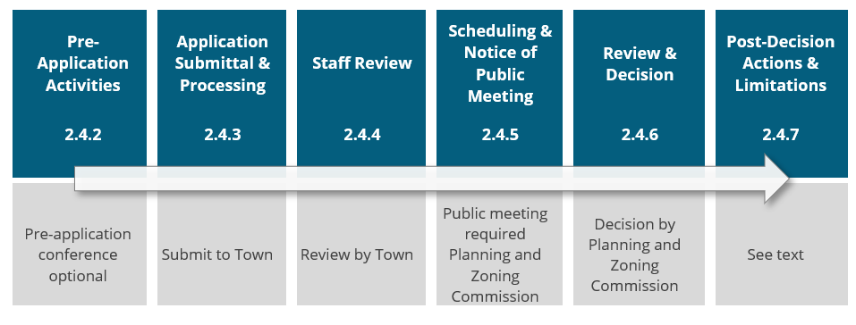
Subdivision | Final Plat
Follows Preliminary Plat or Preliminary Replat
Must be submitted within 2 years of Preliminary Plat or Replat approval
Final plats do not require public hearing (consent agenda item)

Slide 28
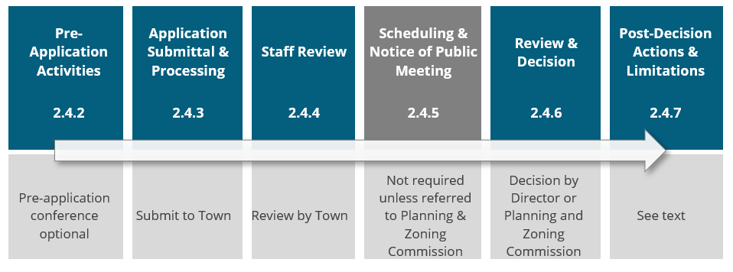
Subdivision | Minor Plat
Procedure applies to plats that:
  Involve four or fewer lots
  Front onto an existing street
  Do not require dedication of public right-of-way or other public improvements; and
  Do not require the creation of any new street or the extension of municipal facilities.

Slide 29
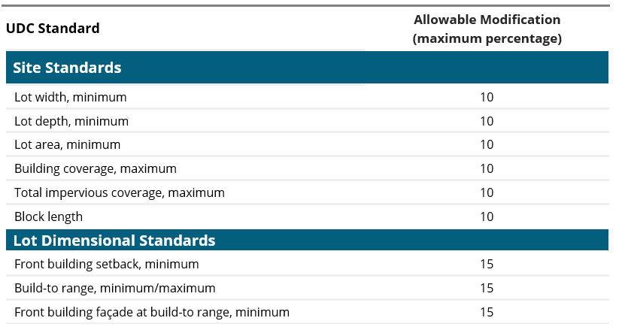
Flexibility & Relief Procedures
Variance: allows for variance from development standards if hardship demonstrated
Subdivision Variance: allows for variance from subdivision standards to address unforeseen circumstances (required to go to P&Z)
Minor Modification: allows modifications from the dimensional or numerical standards of the UDC (see right)

Slide 30
Flexibility & Relief Procedures
Alternative Equivalent Compliance: allows the Director to approve a site-specific plan that is equal to or better than the strict application of the standard (more qualitative than quantitative)
Appeal of Administrative Decision: procedure to appeal decision made by the Director or other administrative official (not P&Z/CC)
Interpretations: mechanism for rendering formal written interpretations of the UDC

Slide 31
Other Procedures
Zoning Text Amendment: process for amending, changing, or supplementing content of the UDC (City Council)
Comprehensive Plan Amendment: process for amending the Addison Comprehensive Plan (City Council)
Concept Plan: new process to review large, complex, or phased projects as a precursor to submitting more specific and detailed plans (City Council)
Temporary Use Permit: process to enforce temporary use regulations (Director)
Sign Permit: process to enforce sign regulations (Director)
Zoning Verification Letter: new process for Town to issue a formal confirmation of a property’s zoning (Director)
Development Agreement: Coordinates the provision of adequate public facilities to serve development, the phasing of development, and administering management efforts to maintain open space and environmentally sensitive lands

Slide 32
Article 2: Zoning Districts
Notes:
Tareq

Slide 33
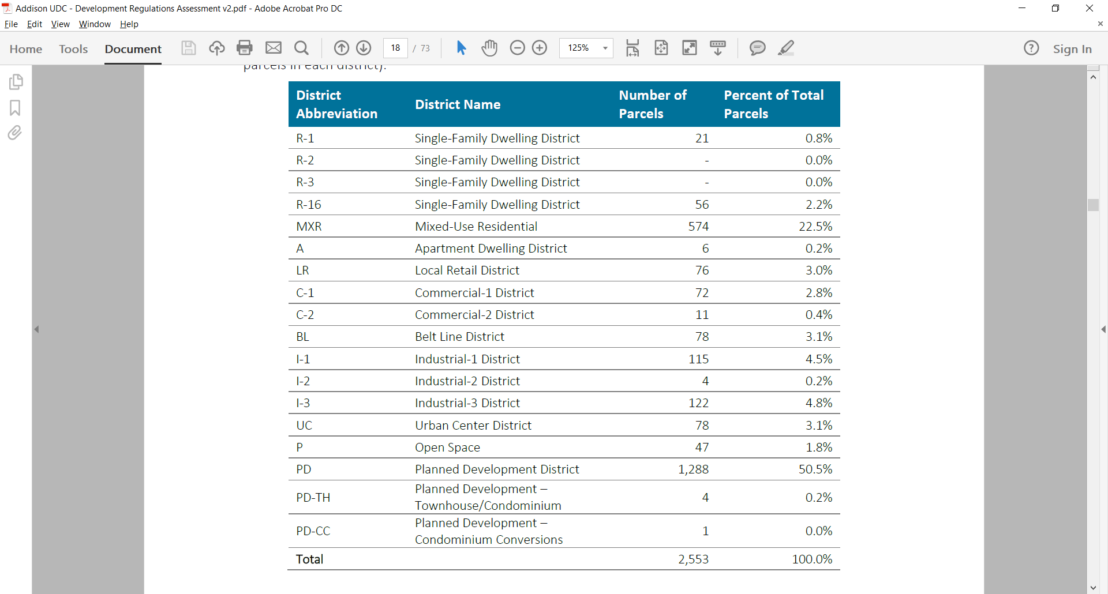

Slide 34
General Approach to Revising zoning districts
Substantial changes to existing zoning are not contemplated as part of this project.
Rather, need to “clean up” the district lineup:
  Move from a district-based approach to a townwide approach
        (Example: Allow Addison Circle and Belt Line zoning tools to be used in other places)
  Reorganize, rename, and clean-up existing districts
  Establish a more rational menu of tiered districts to encourage future by-right development (versus always having to negotiate PDs)

Slide 35
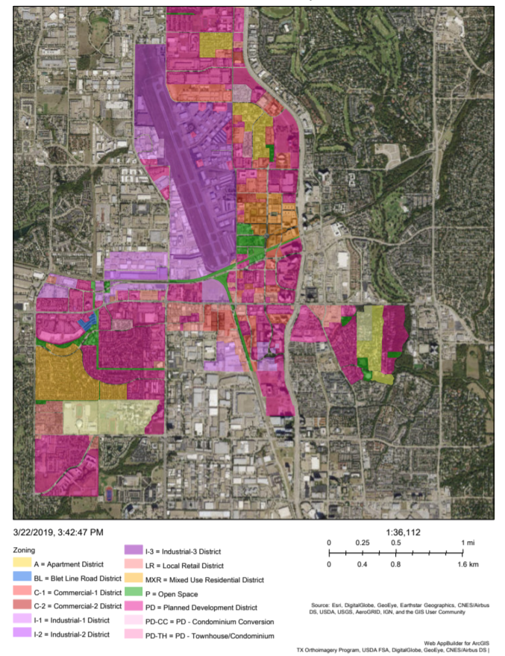
Fine-tune the zoning districts
Factors for consolidation
  Similar purpose
  Similar lot and building standards
  Similar uses permitted
Factors for elimination
  District rarely or never applied
  Intent can be met by another district
Factors for establishing new
  Current districts don’t achieve desired result

Slide 36
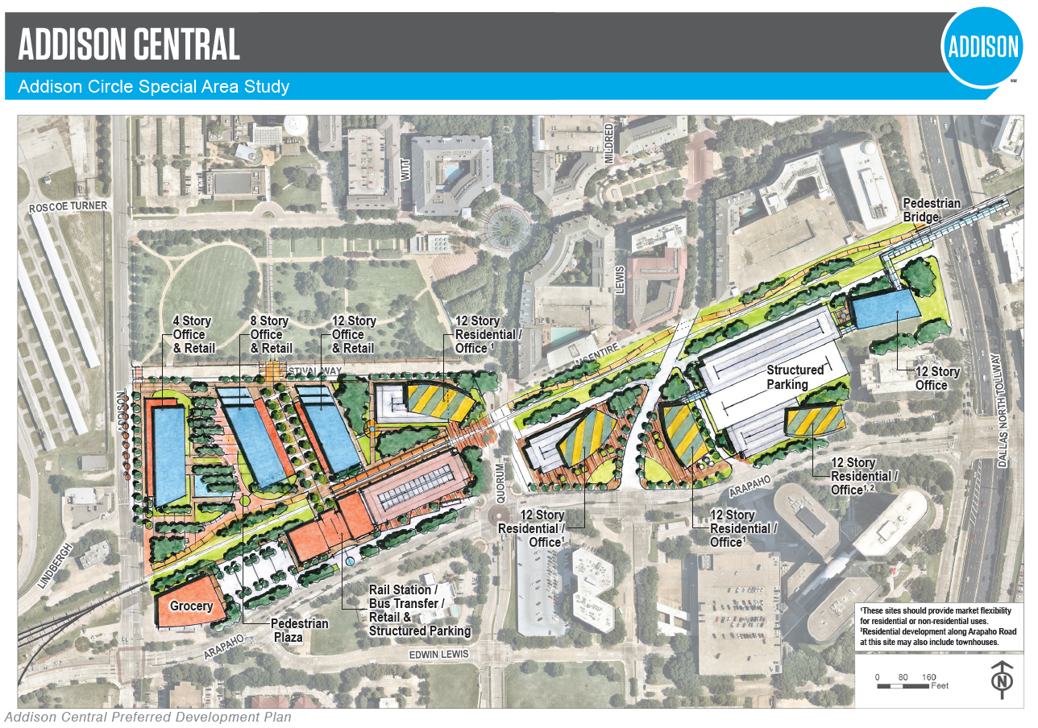
Fine-tune the zoning districts
Consolidate similar districts
  C-2, I-1, I-2
Eliminate “obsolete” districts
  R-2, R-3, PD-CC
Convert subdistricts to base districts
  MXR
  UC
Retain outdated districts as “legacy districts”
  A, PD-TH
Update district naming conventions
Establish new districts
  M-3, CF

Slide 37
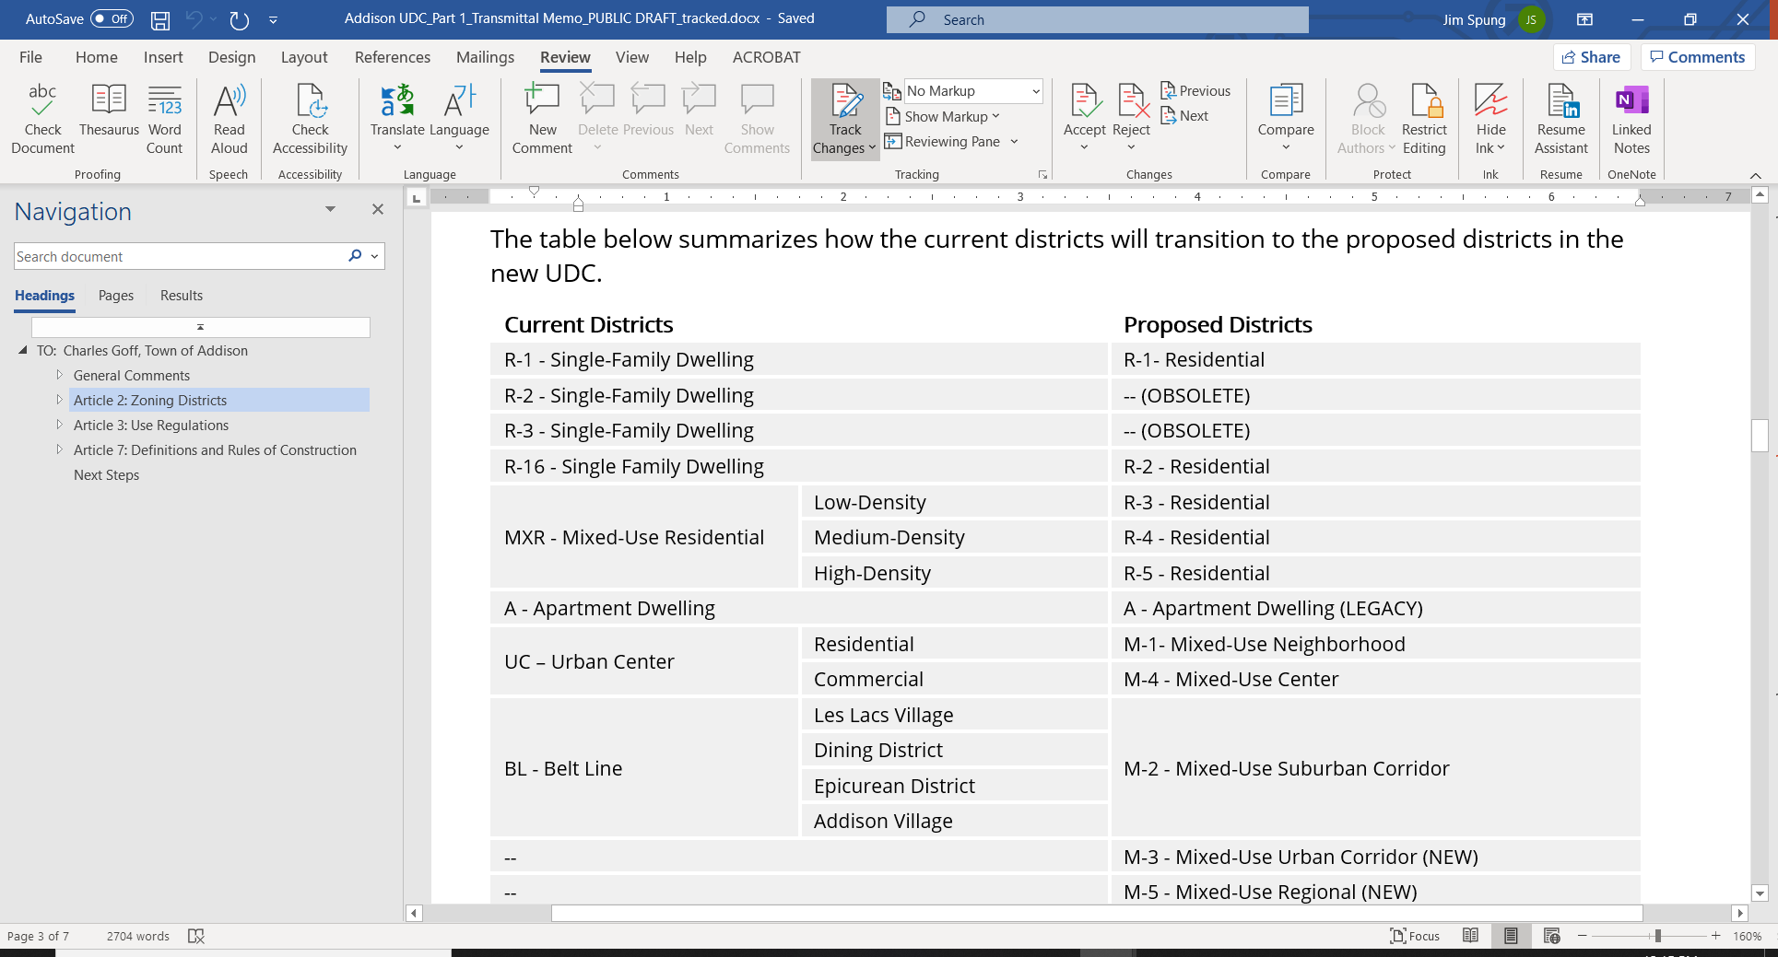
Residential zoning districts

Slide 38
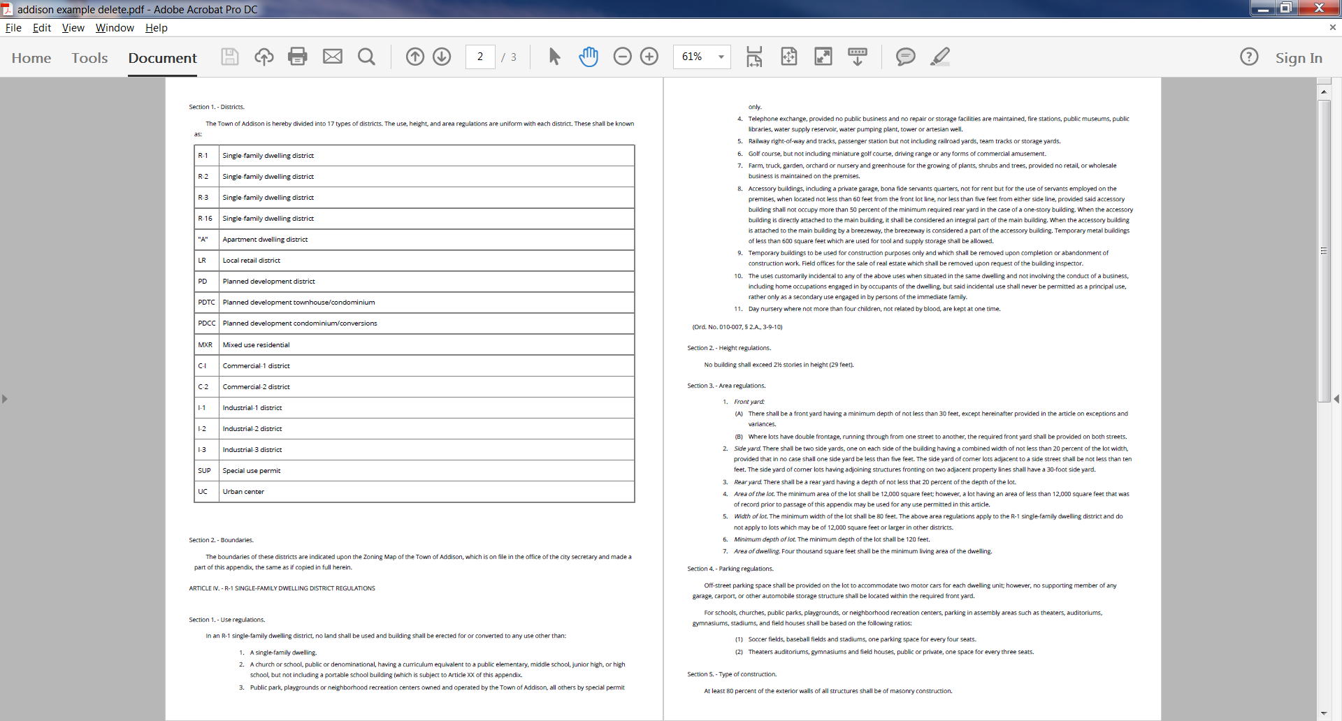
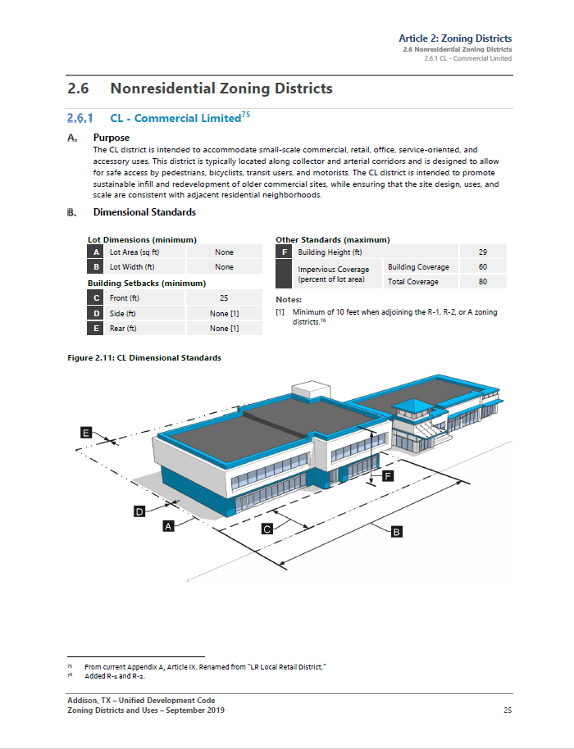
improved page layout

Slide 39
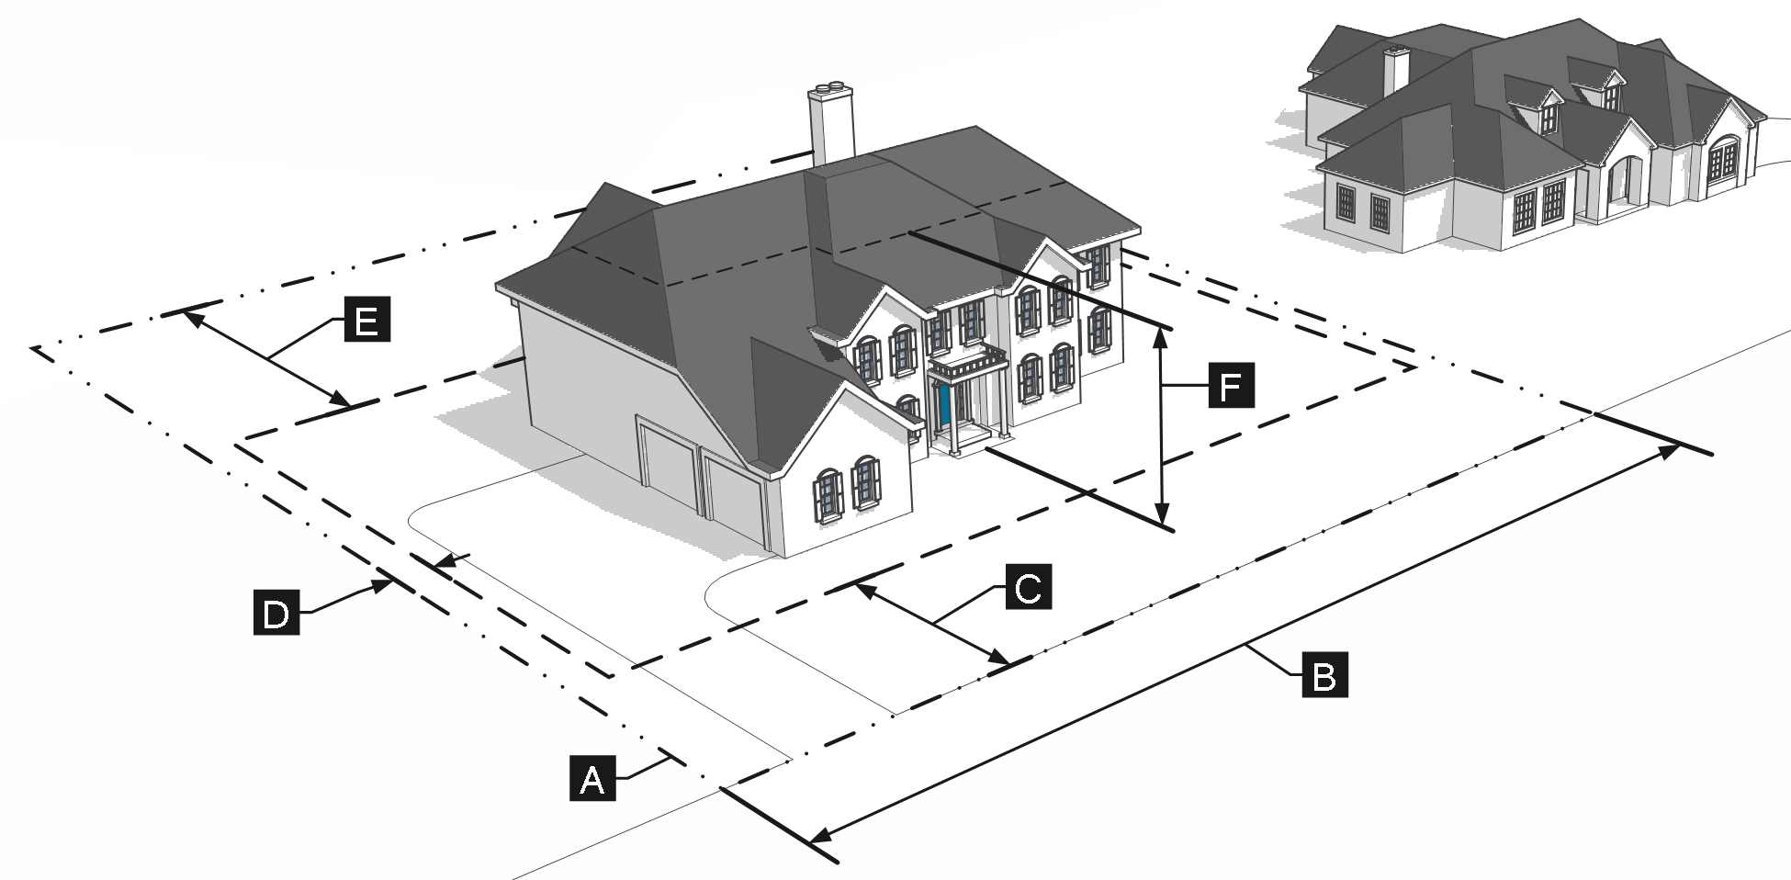
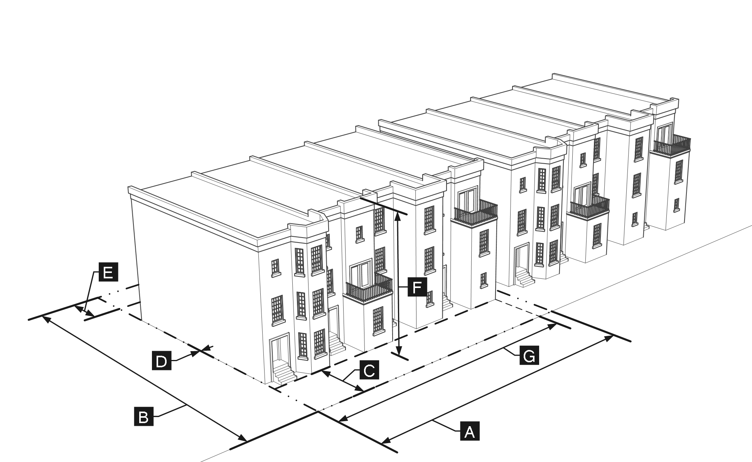
R-1
R-4
Removed minimum dwelling size
(except for multifamily uses)

Slide 40
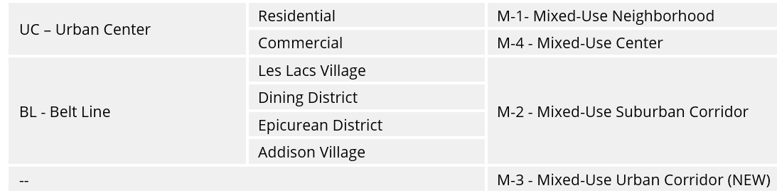
Mixed-Use zoning districts

Slide 41
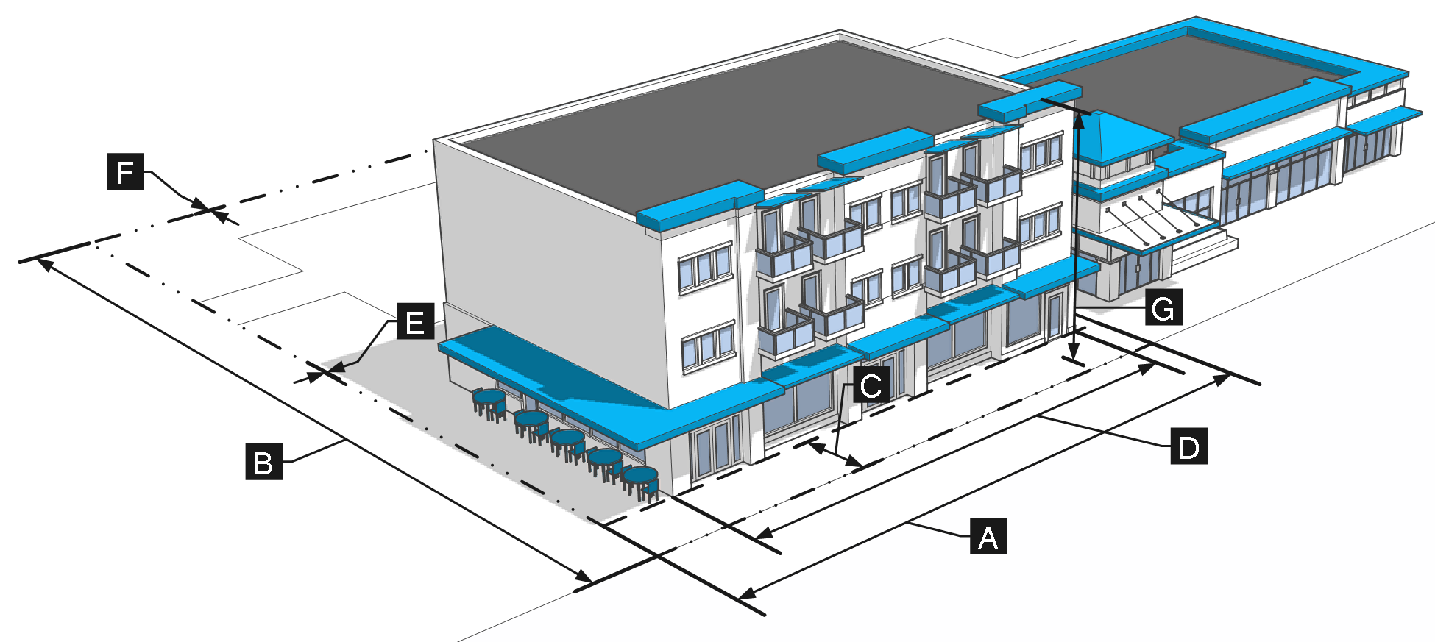
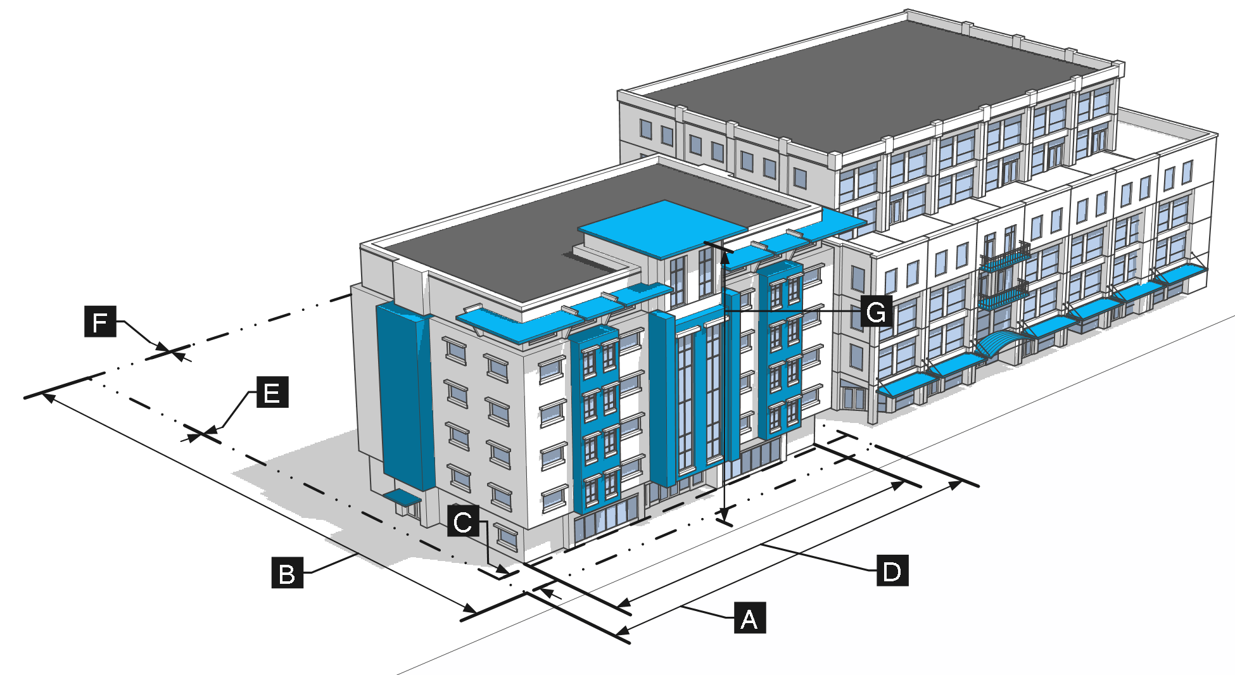
M-1
M-2
- Replaced “build-to-line” with “build-to-range” for added flexibility
- New minimum residential density standards to support pedestrian/transit environment

Slide 42
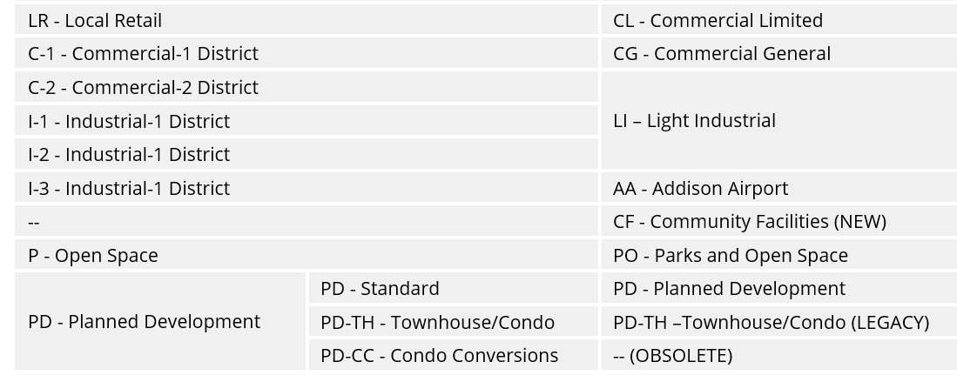
Nonresidential zoning districts

Slide 43
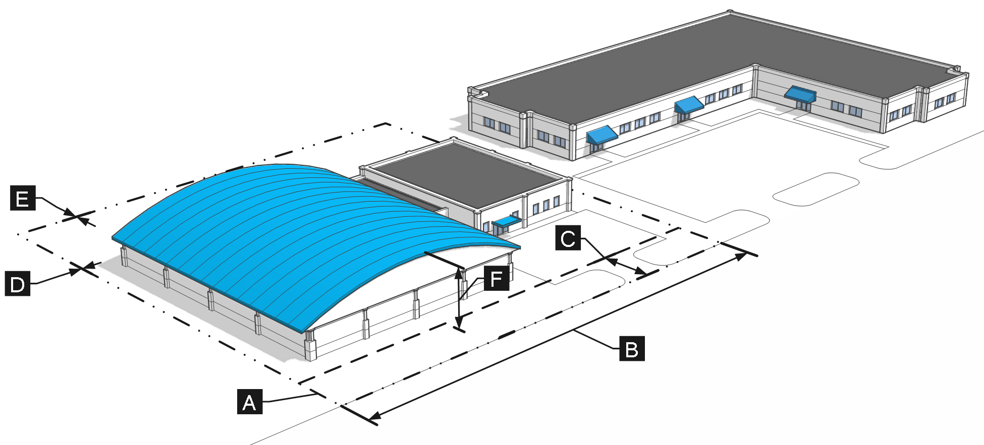
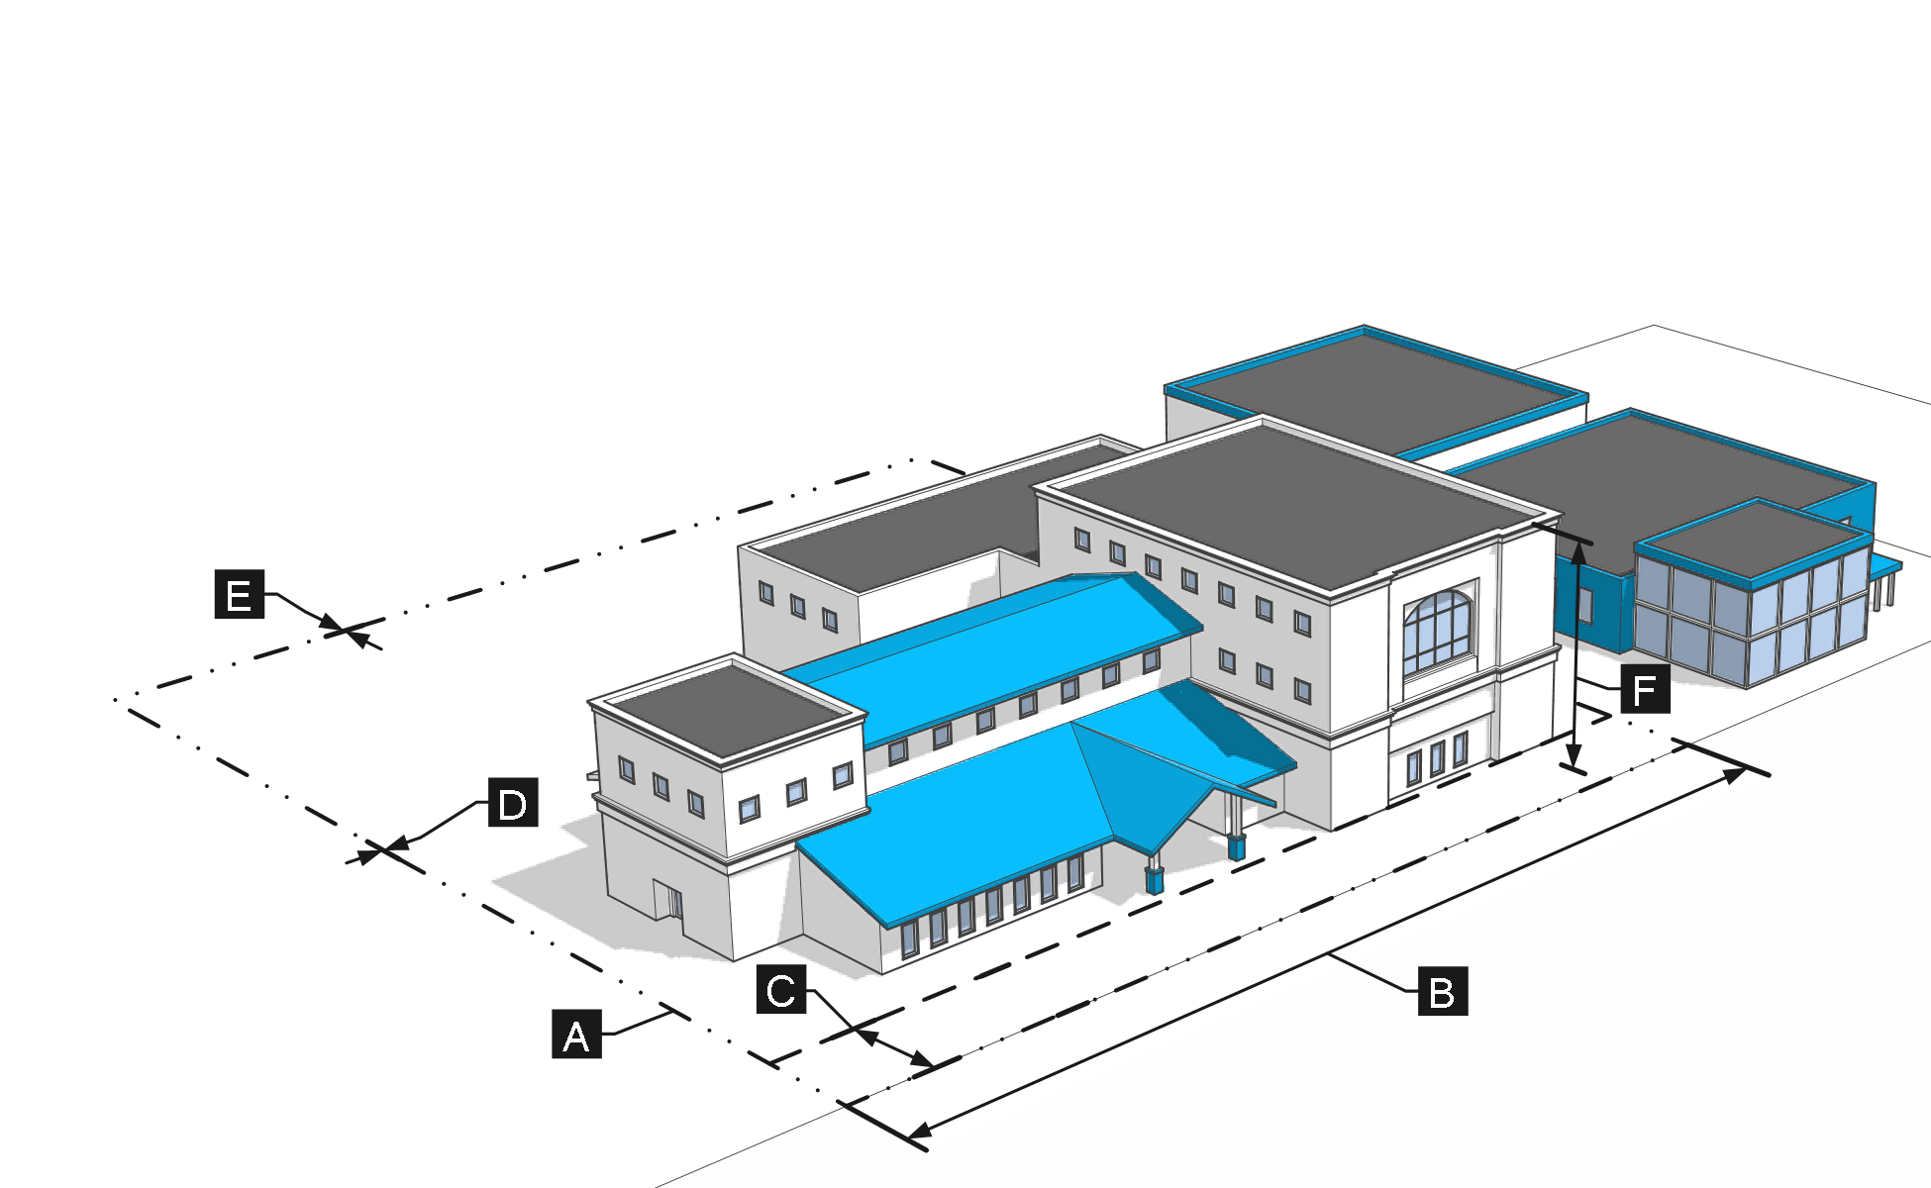
AA
CF
Included impervious surface coverage standards for all zoning districts

Slide 44
Planned Development
Revised purpose statement:
  Clarifies that this is a unique tool for special cases
  Requires public benefits in exchange for flexibility
Established qualifying criteria for projects seeking PD zoning:
  Not located in the M-4 (mixed-use center)
  Couldn’t otherwise be developed using standards in a base district

Slide 45
Article 3: Use Regulations
Notes:
Tareq

Slide 46
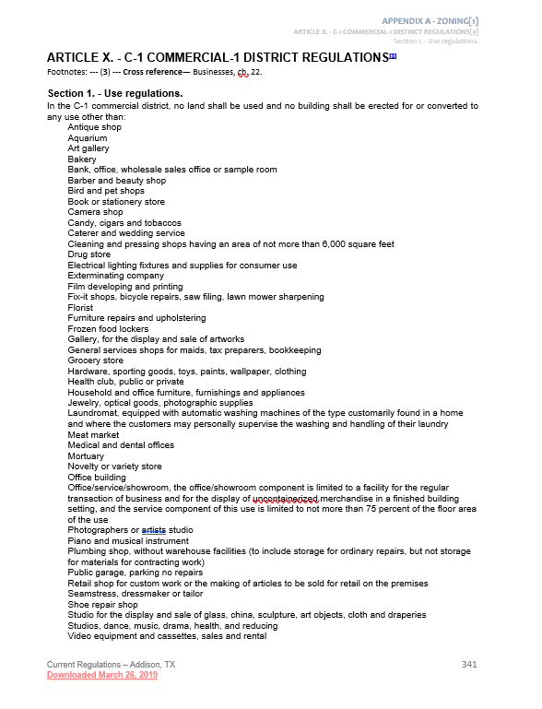
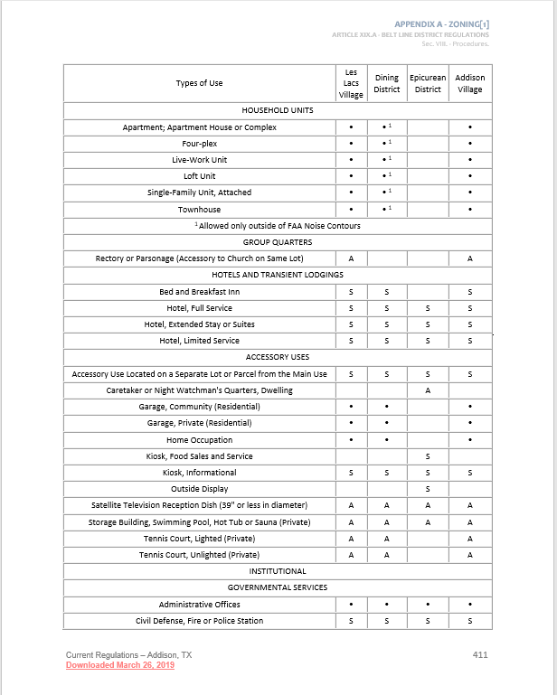
current use lists

Slide 47
new consolidated use table

Slide 48
New Use type Examples
Cottage development
Continuing care retirement facility
Supportive housing
Cemetery or internment facility
Treatment facility
Rehabilitation facility
Mobile food truck park
Credit access business
Building supply store
Equipment sales or rental
Vehicle repair (major)
Noncommercial urban agriculture
Artisan manufacturing
Contractor’s office
Warehouse or wholesale facility
Self-service drop box
Accessory dwelling unit (ADU)

Slide 49
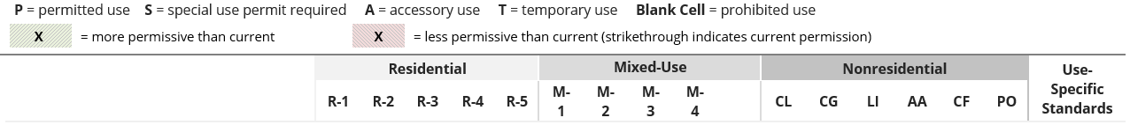
Proposed Changes: Restaurants
Proposed: Removed SUP requirement for accessory alcohol sales, but maintained SUP requirement for restaurants
  Additional standards for restaurants with late-night hours addressed through use-specific standards
      In the M-1, M-2 and M-3 zoning districts, restaurants that operate after 12:00 a.m. shall close all outdoor seating areas and turn off amplified sound by 10:00 p.m.
  Drive-throughs limited to the M-2 district – not allowed in all other mixed-use districts

Slide 50
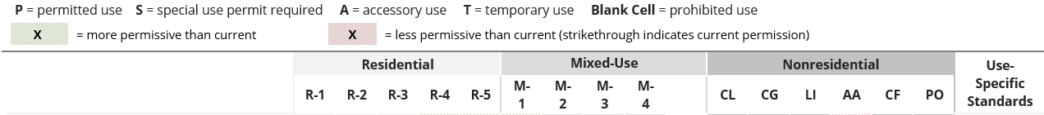
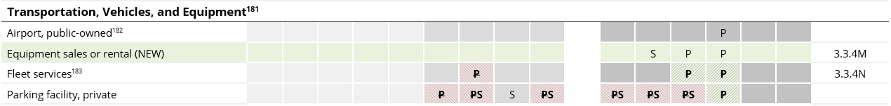
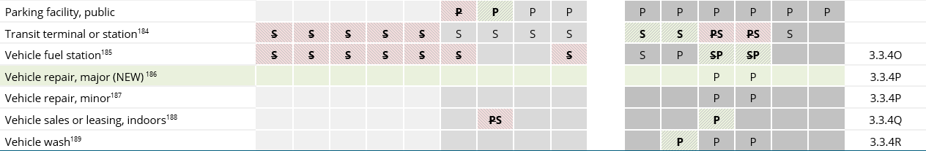
Proposed Changes: Auto-related uses

Slide 51
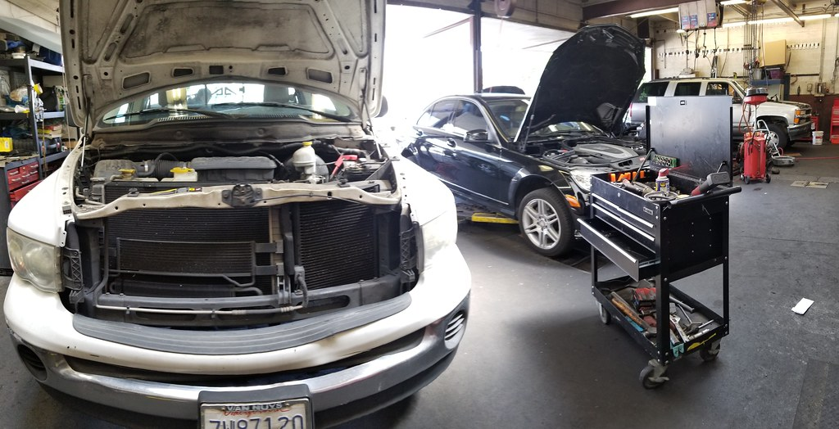
Proposed Changes: Auto-related uses
Proposed new standards:
Vehicle fueling stations
  Min. 100 feet of frontage on arterial road
  Site access from arterial road required
  Allowed by right in CG and LI
  CL district requires SUP and limited to four fuel pumps
Vehicle repair (major & minor)
  Both allowed in LI and AA
  All activities inside building
  No outdoor storage allowed
Vehicle sales or leasing
  Indoor operations and display only – no repair
DISCUSSION:
- Should fueling stations be allowed in Mixed-Use zoning districts with a limited number of pumps?

Slide 52
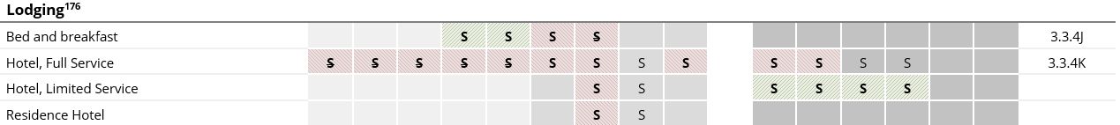
Proposed Changes: lodging uses
Currently: Multiple definitions for “hotels” that vary by district
  Belt Line district distinguishes lodging uses (full service, limited service, extended stay) but terms not defined; few parcels are zoned in this district
  Outside of Belt Line and Addison Circle, all hotels must be “full-service hotel”
  Other districts currently allow full-service hotels with SUP approval
Proposed:
  Unified approach, town-wide definitions of hotel types and updated use table

Slide 53
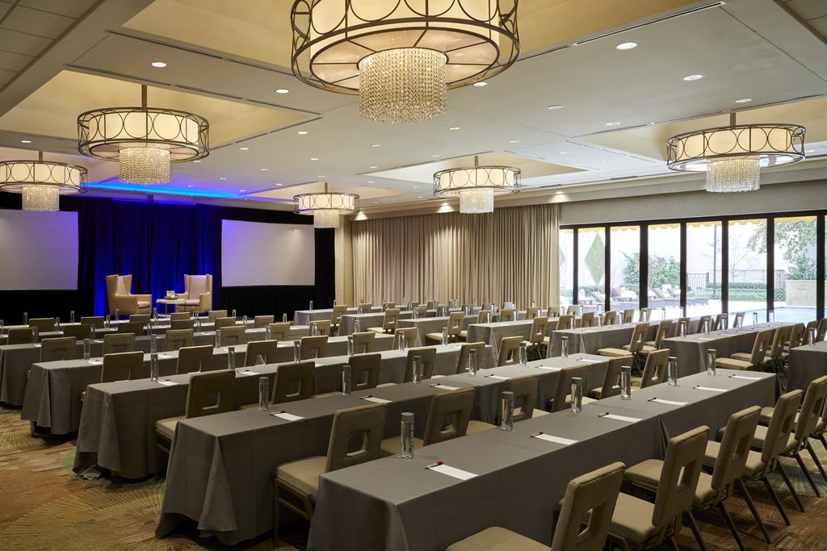
Full-service hotel requirements
Entrance from a completely enclosed area required (access from courtyard or swimming pool area allowed for first-floor units)
Must have lobby, fitness center, full commercial kitchen, and 5,000 square feet of meeting facilities
Not more than 30 percent of rooms may be suites, defined as:
  Rooms with a kitchenette; or
  Rooms with a parlor and sleeping area separated by a floor to ceiling partition

Slide 54
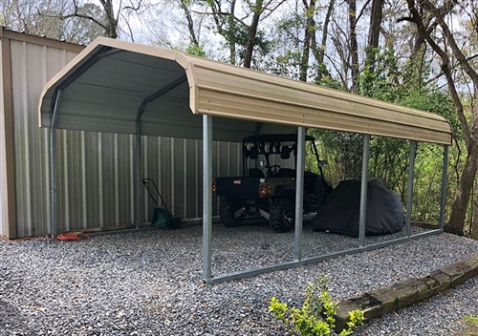
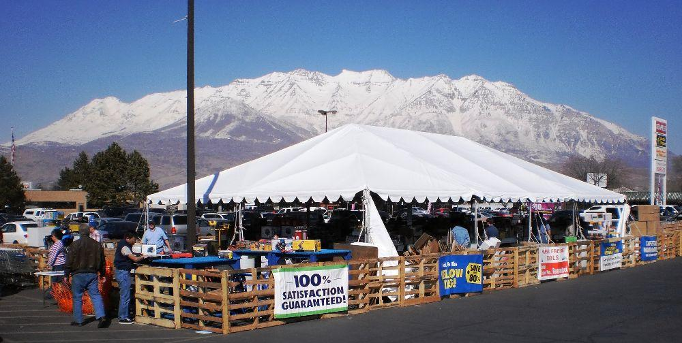
temporary & Accessory uses
  Both topics are not clearly addressed in current regulations
  Consolidated and updated accessory use/structure standards
  Created new town-wide temporary use/structure standards

Slide 55

Accessory Dwelling Units
Only allowed on lots with single-family dwelling
Limited to one bedroom
Limited to 50 percent of principal dwelling size
Require separate exterior entrance
Owner is required to live in the principal dwelling or ADU
Mailed notice required to property owners within 200 feet
**see UDC draft for all standards**

Slide 56

Questions & Discussion

Slide 57

Comments?
Remember to use Konveio to record your comments and questions!
You also may submit comments to: udc@addisontx.gov
www.AddisonUDC.org

Slide 58
Next stepS
Mar 2019 – July 2024
July 2024 – Dec 2024

Slide 59
addison, texas unified development code
Part 3 (Procedures) + Part 1 revisit (Districts & Uses)
April 2024

